Slide 1
Heteronuclear NMR experiments for large RNAs
18th NMR Retreat of Protein-RNA Interactions, Parpan, 2024
Jan Marchant
University of Maryland Baltimore County

Slide 2
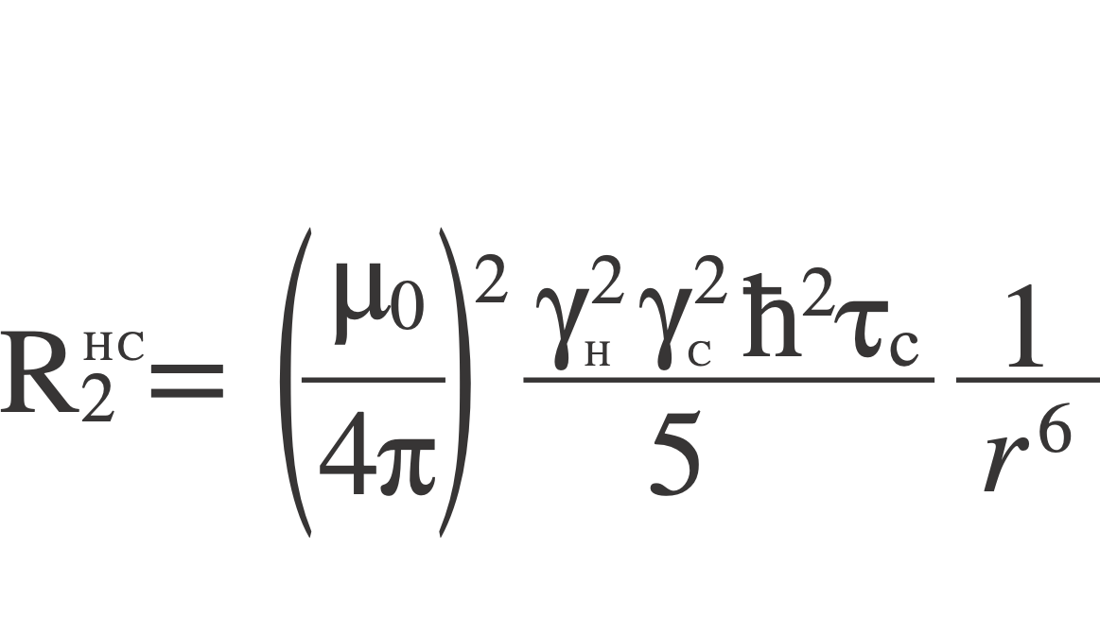
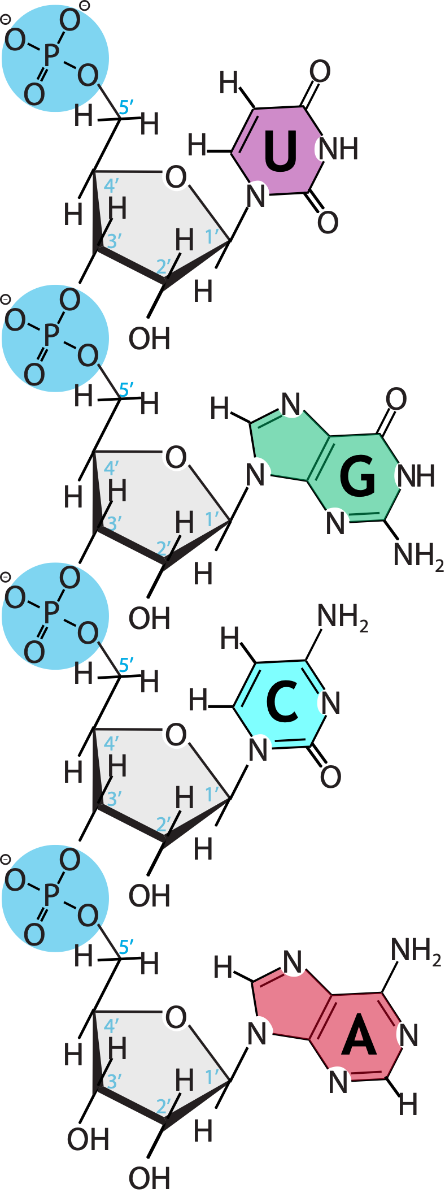
The problem:

Slide 3
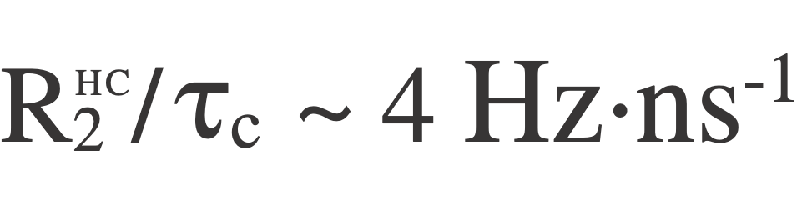
The problem:

Slide 4
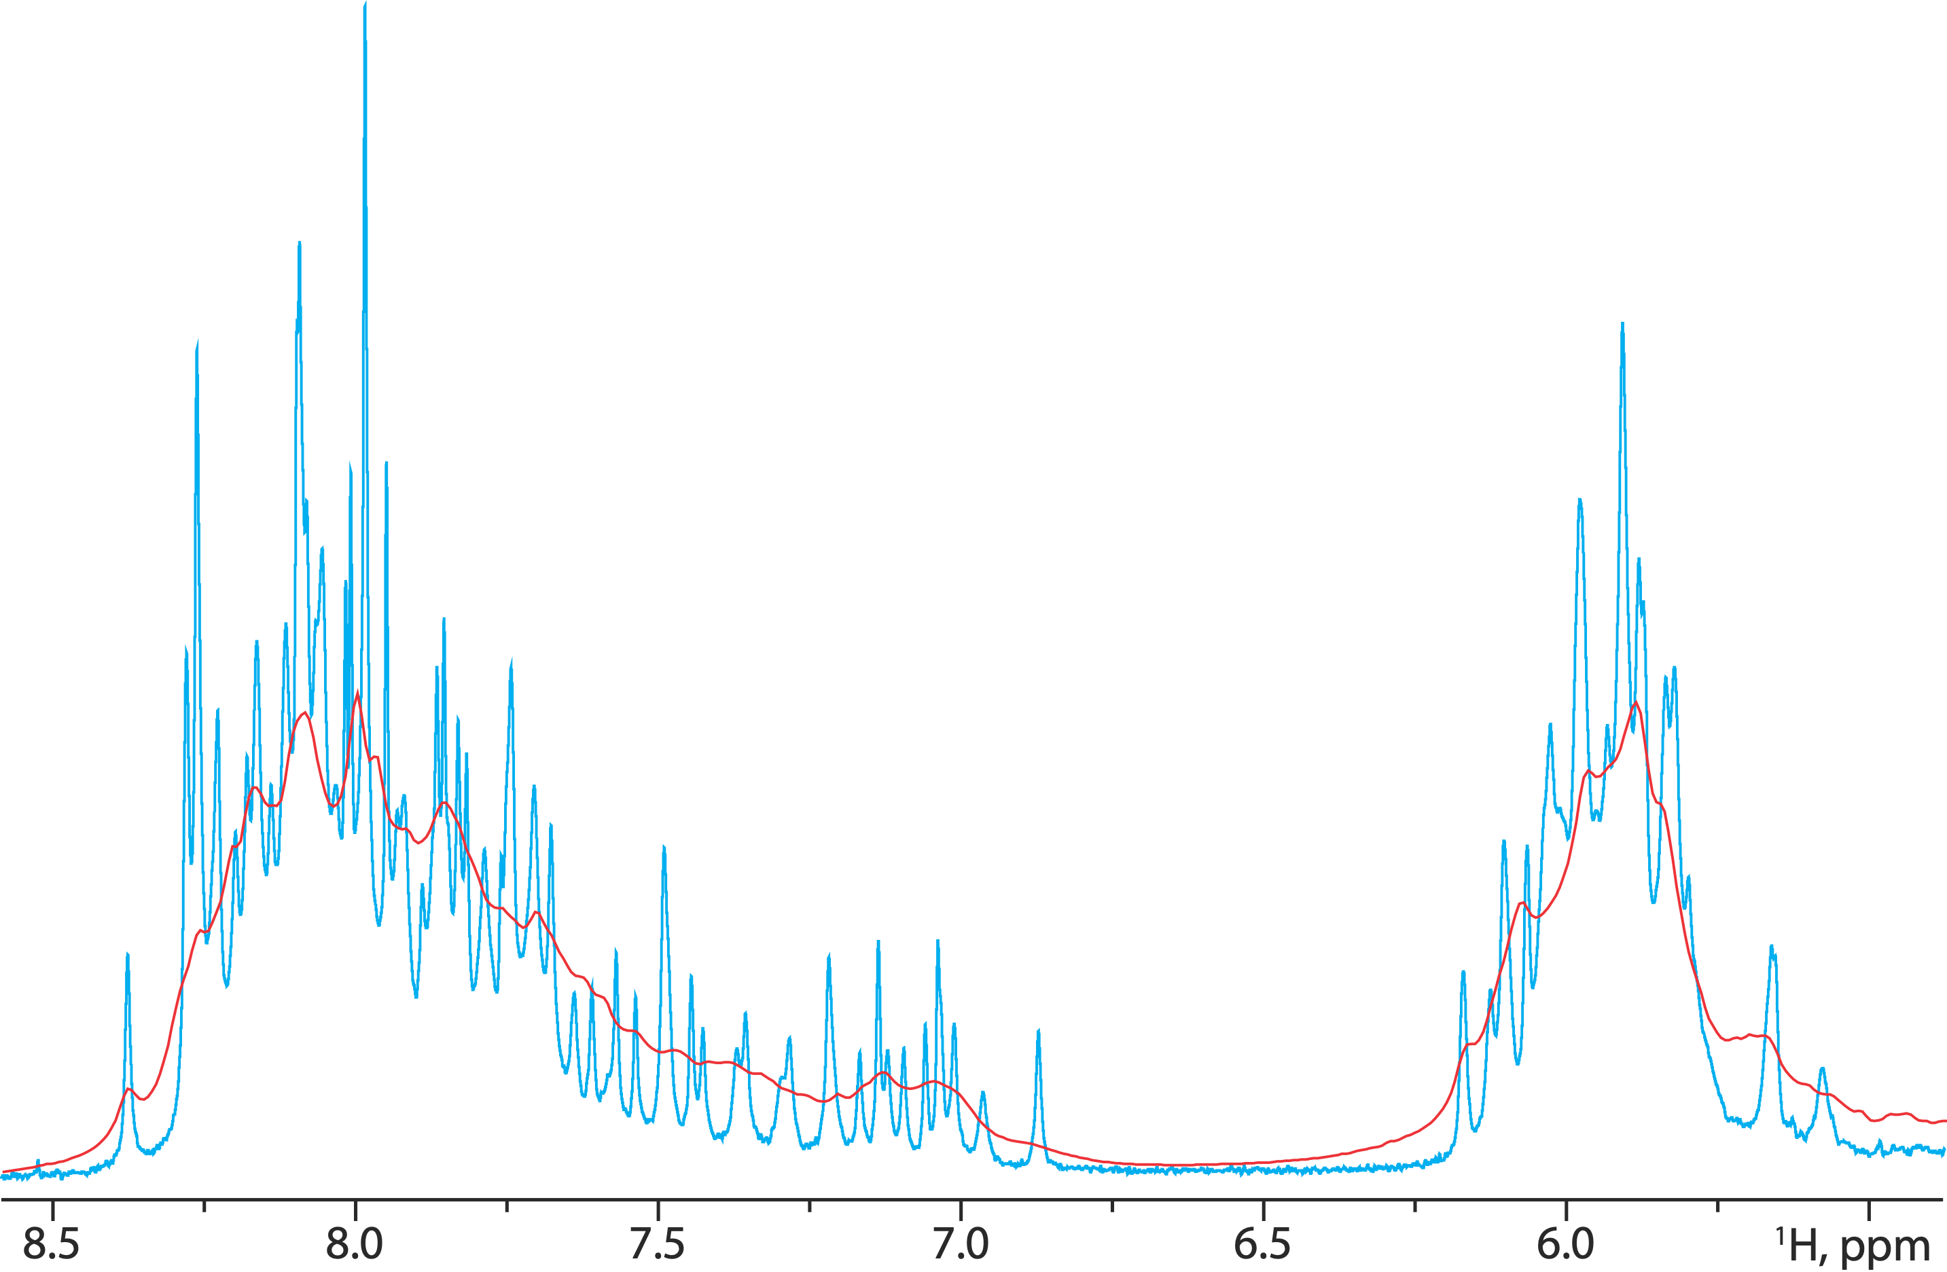
The problem:
232 nt (75 kDa) HIV-1 Rev response element
τc ~ 150 ns
U-¹H A, U-²H GCU
U-¹H; U-¹³C A, U-²H GCU

Slide 5
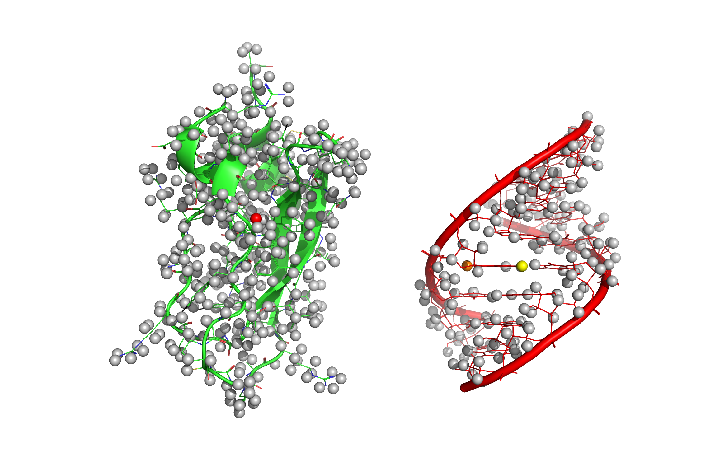
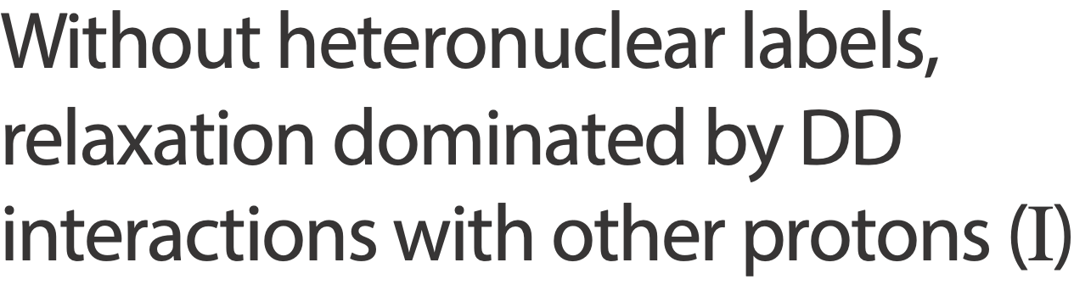
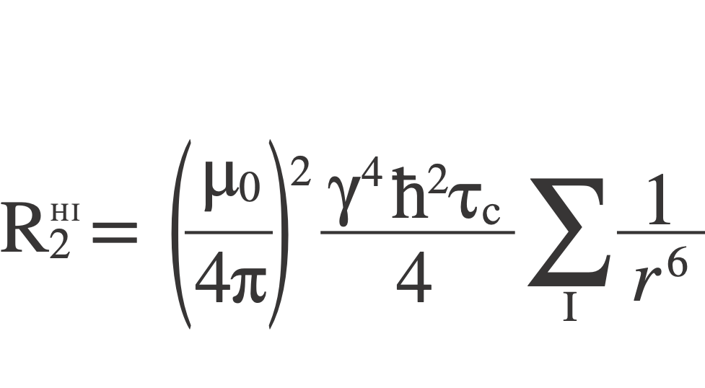



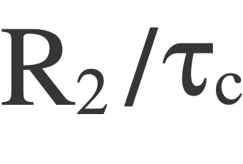
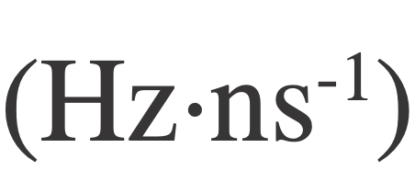
1BPI
2GBH
3.5
0.7
2.6

Slide 6

Exchangeable
1BPI
2GBH
3.5 → 2.5
0.7 → 0.3
2.6 → 2.5

Slide 7
Exchangeable
1BPI
2GBH
3.5 → 2.5
0.7 → 0.4
2.6 → 2.5

Slide 8
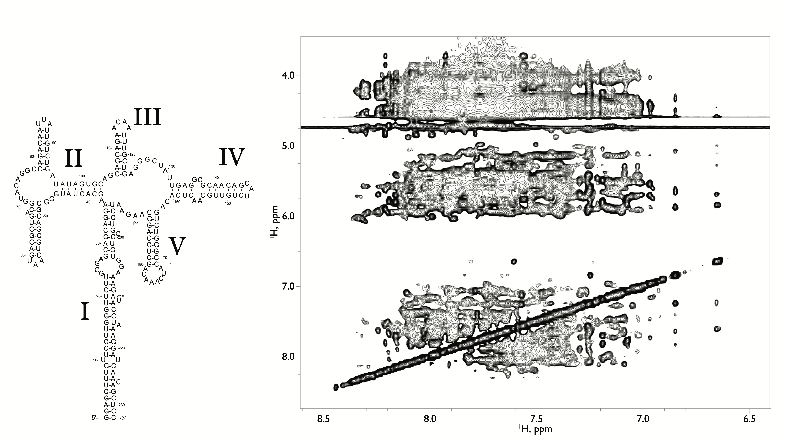

Slide 9
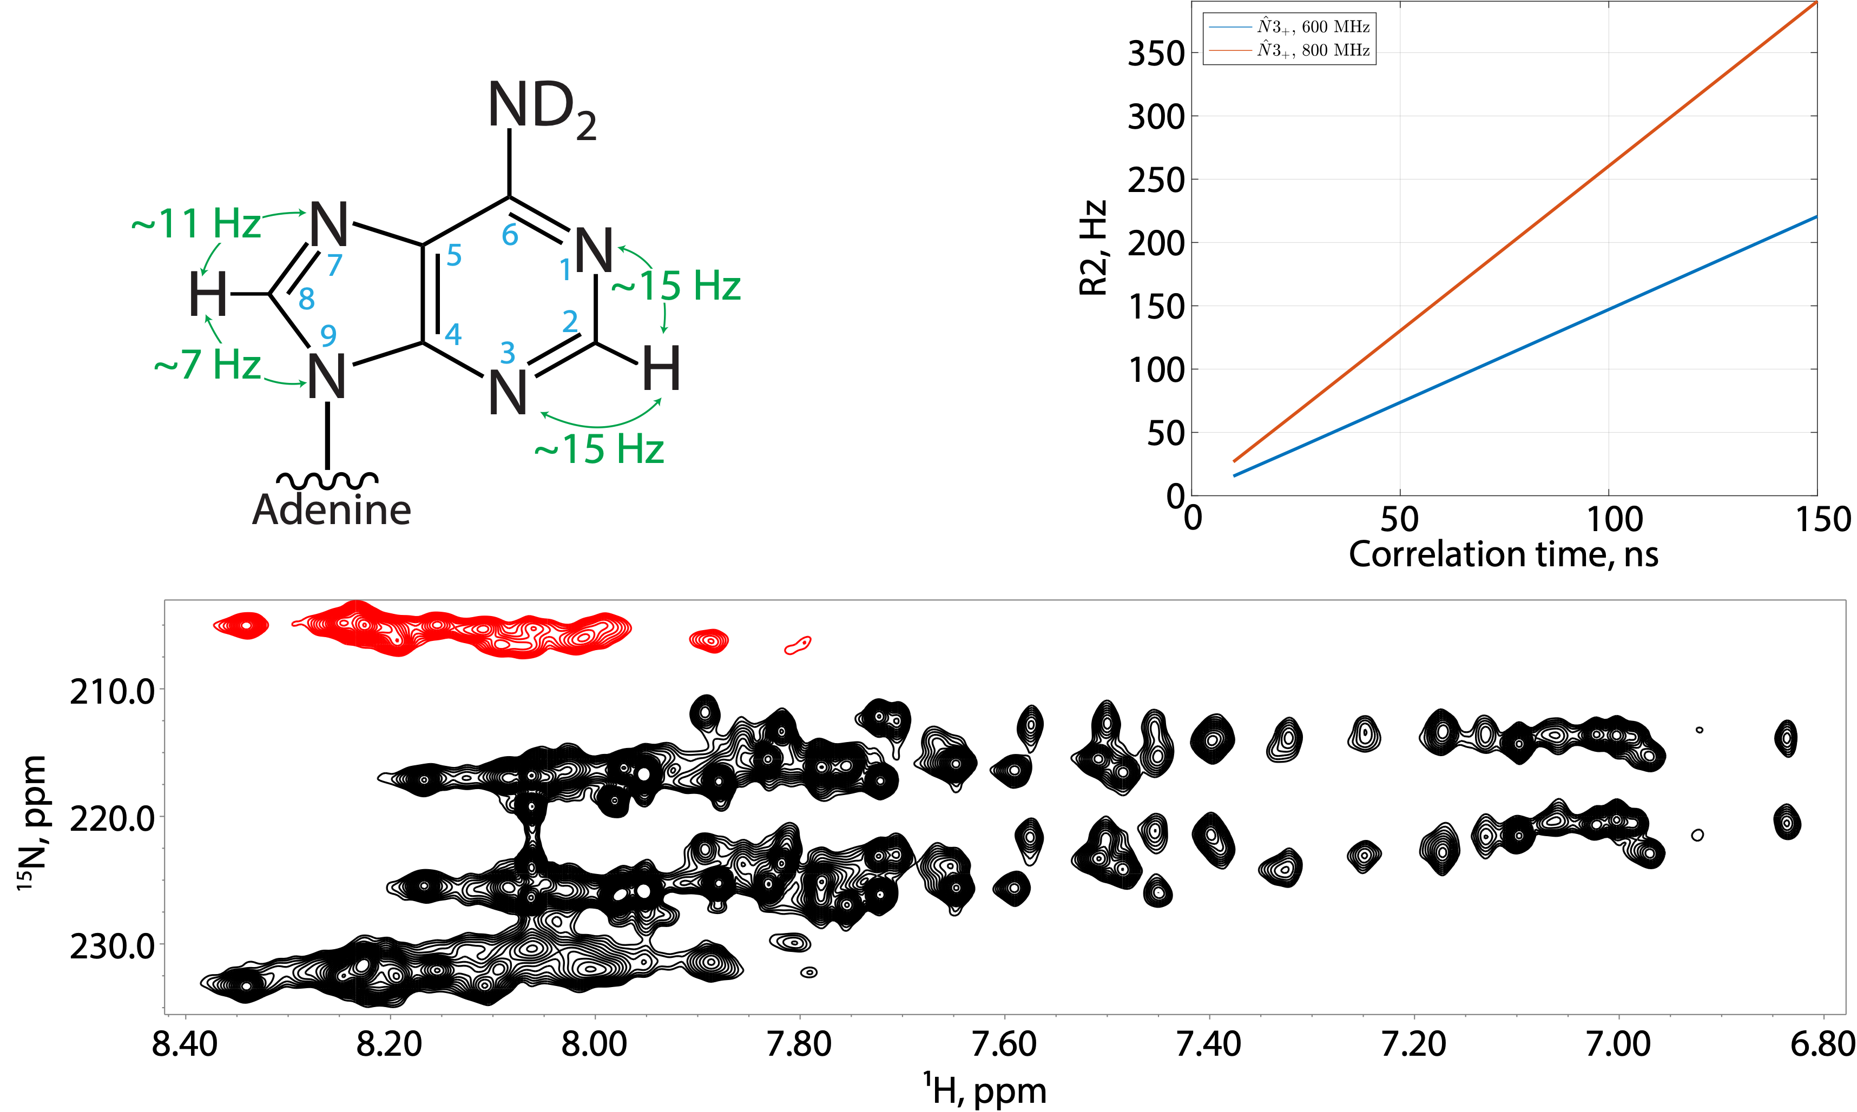


Slide 10
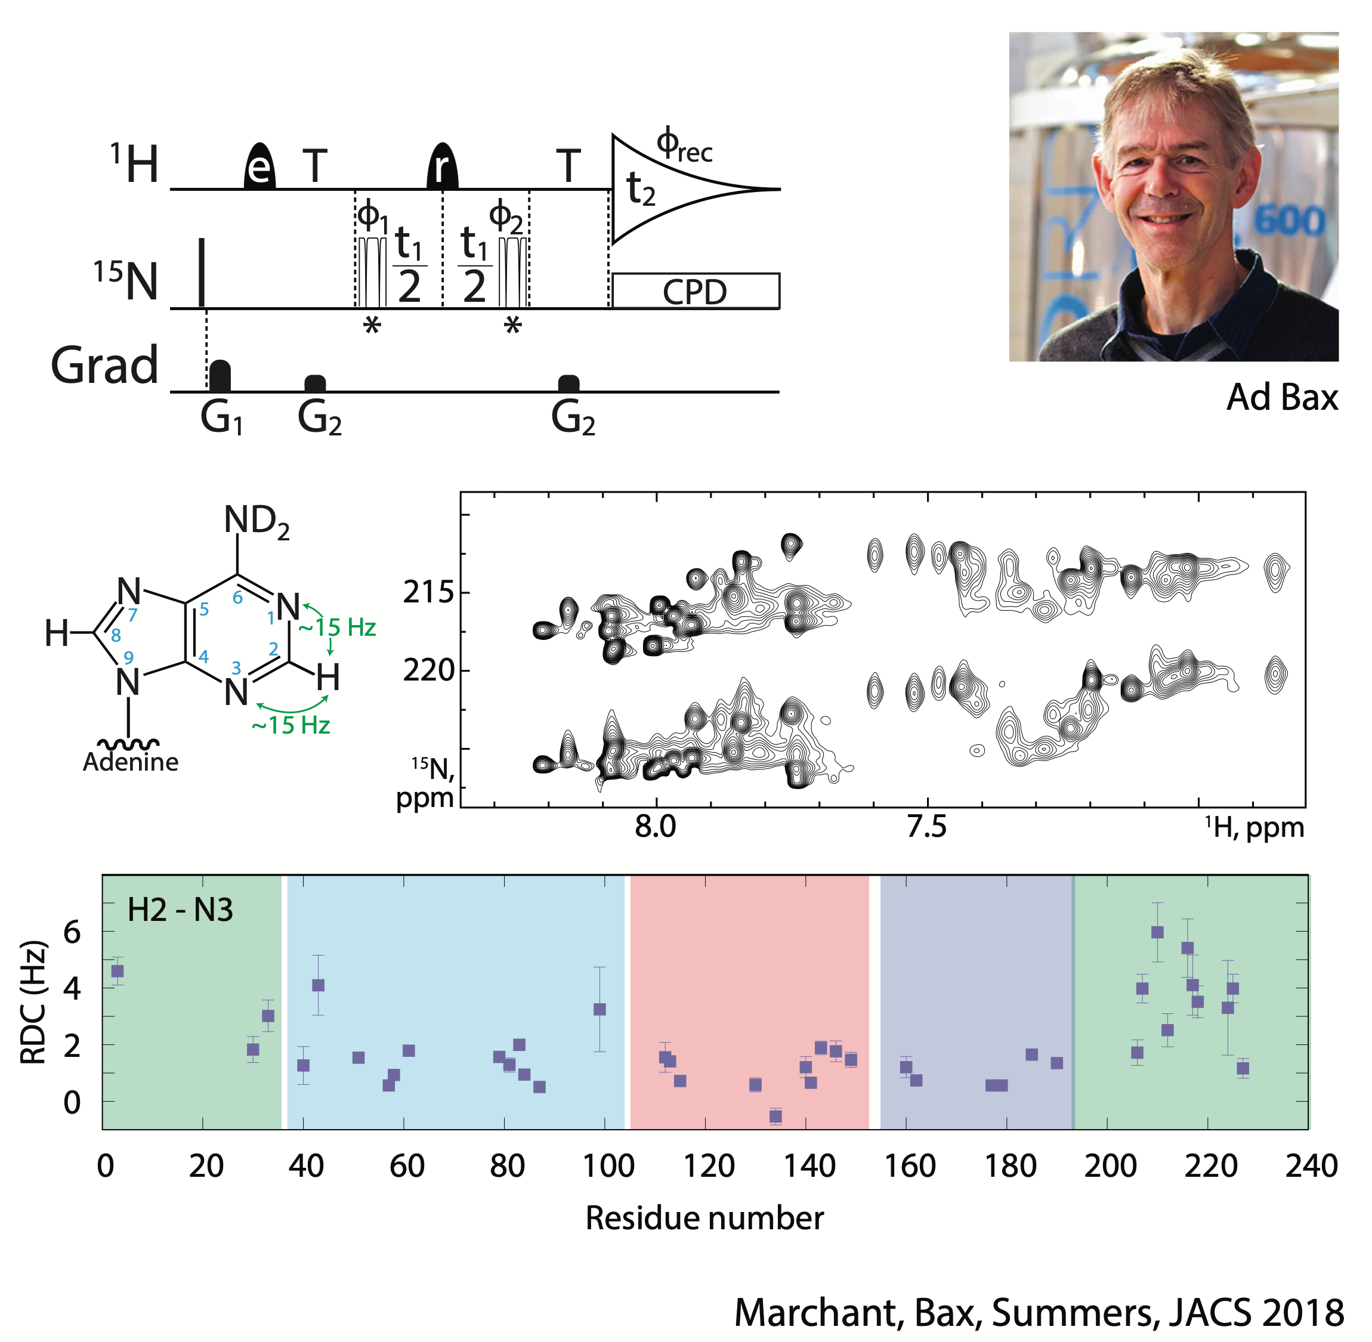
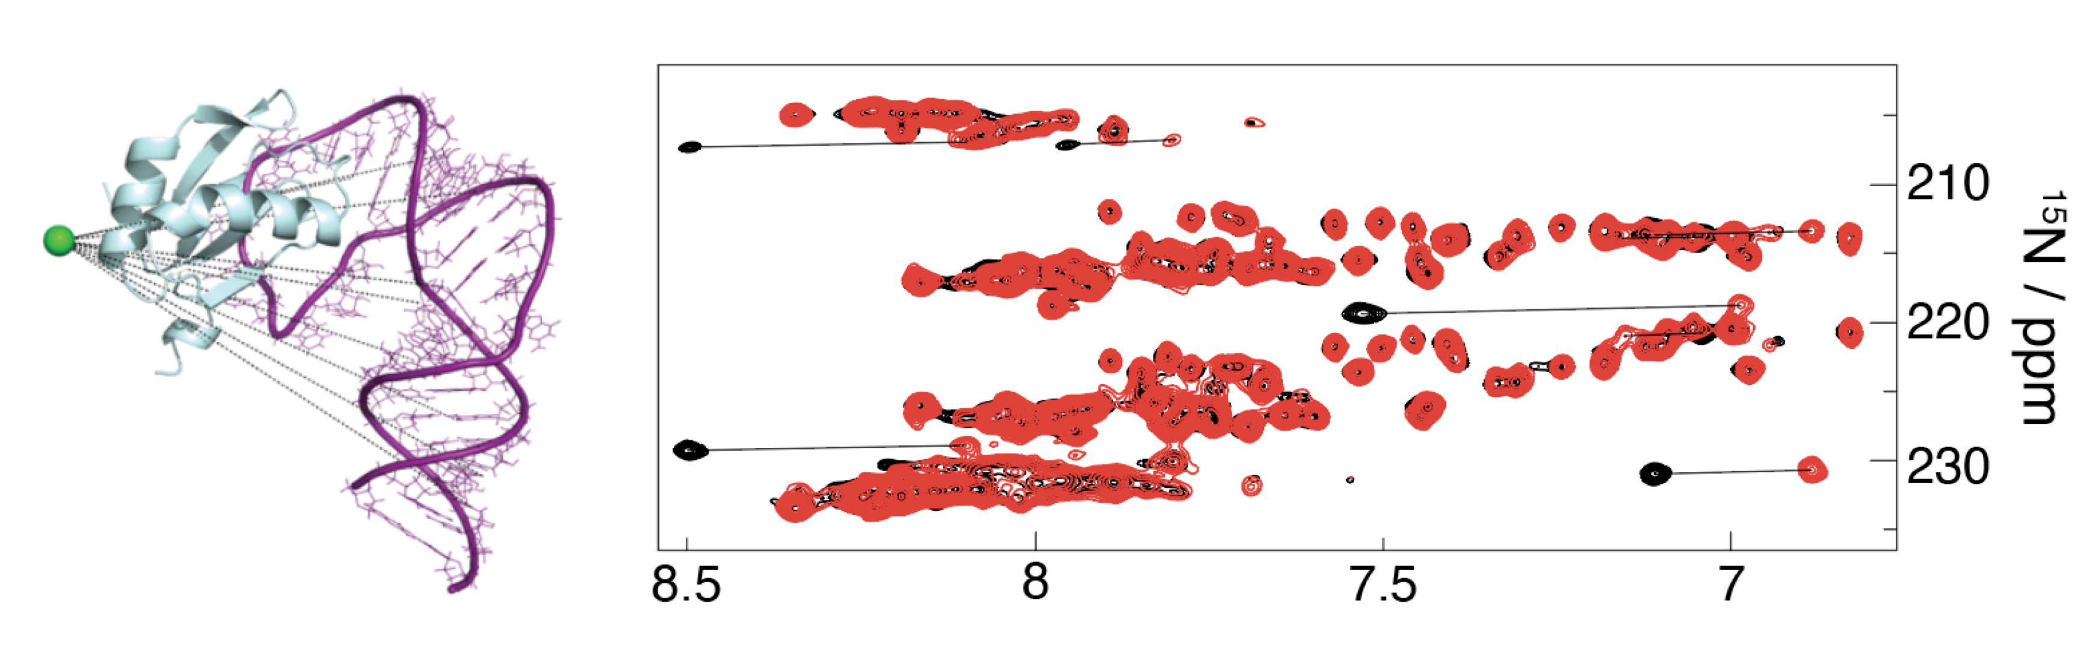


Slide 11
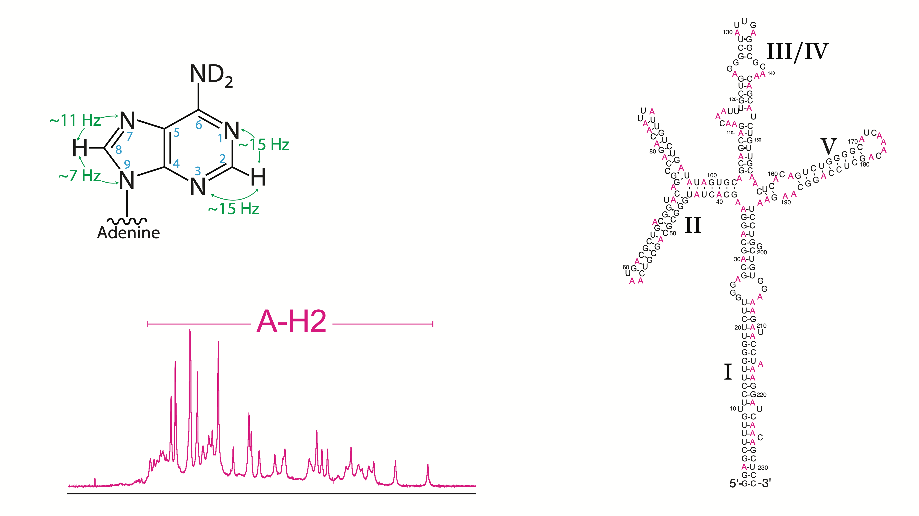

Slide 13
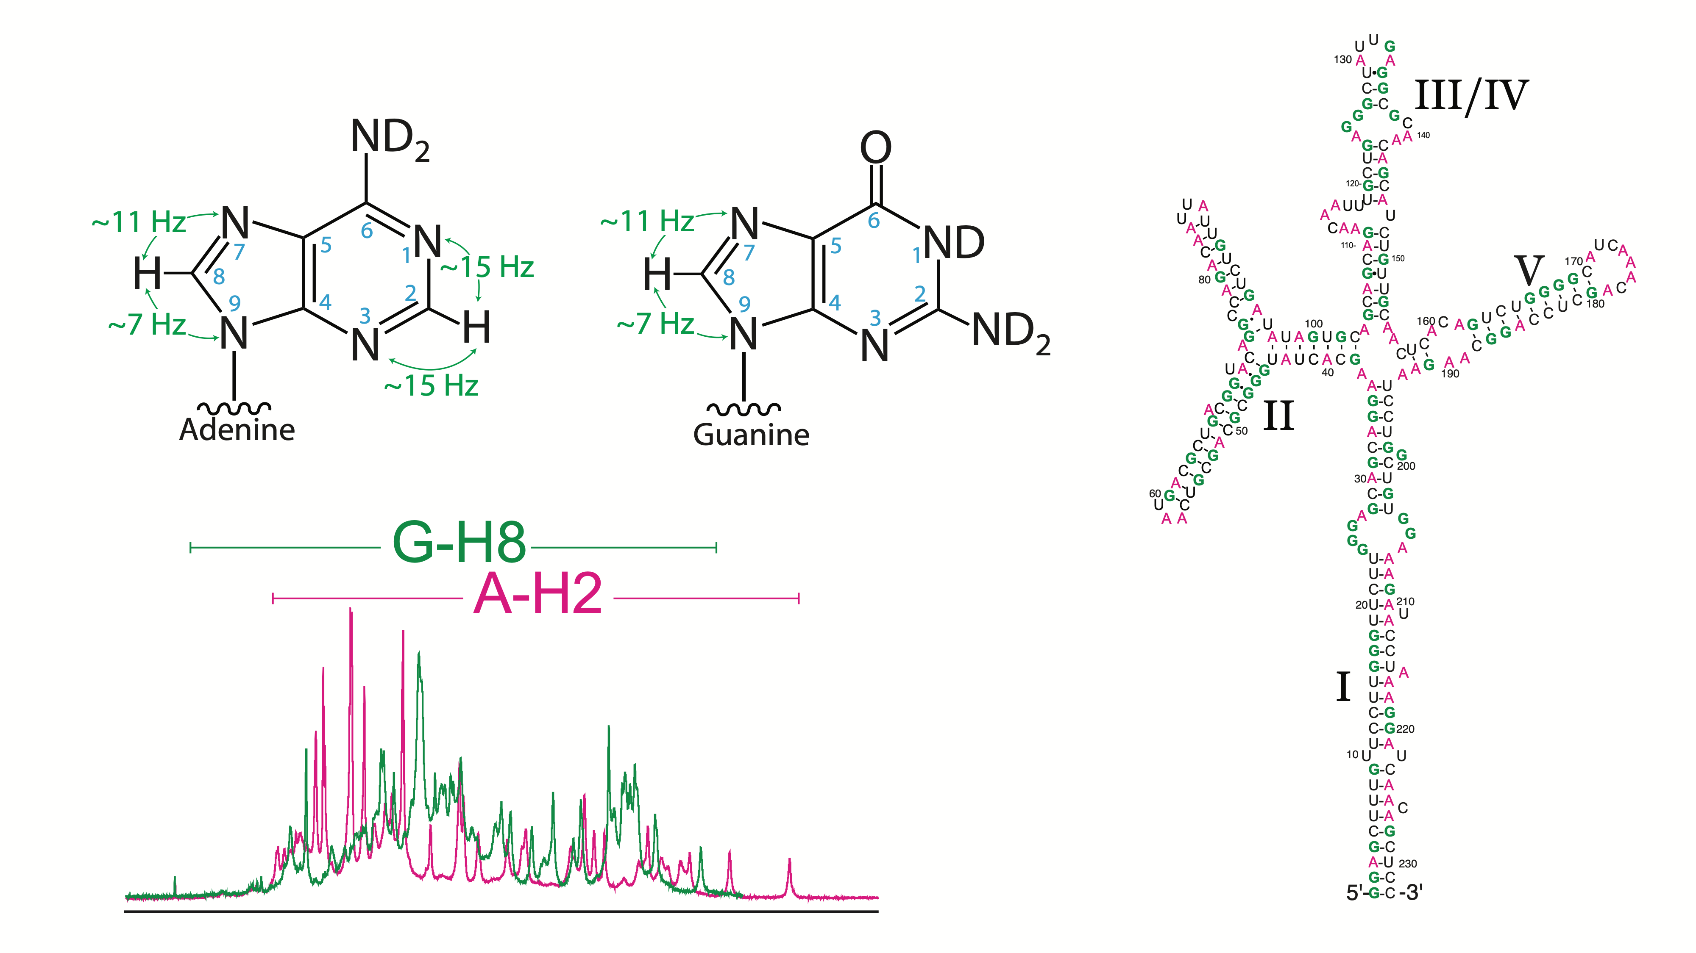

Slide 14
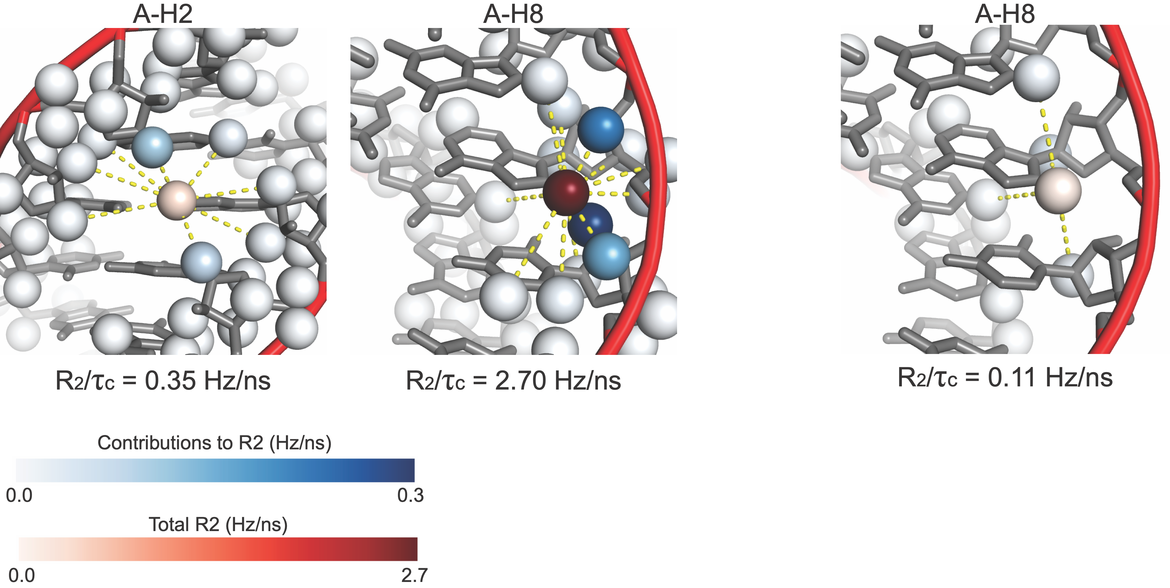
With 100 ns τc , optimal INEPT
delay only retains 3% original
magnetization for H8-N9 transfer

Slide 15
With 100 ns τc , optimal INEPT
delay only retains 3% original
magnetization for H8-N9 transfer
With fully deuterated ribose retain ~ 50%

Slide 16
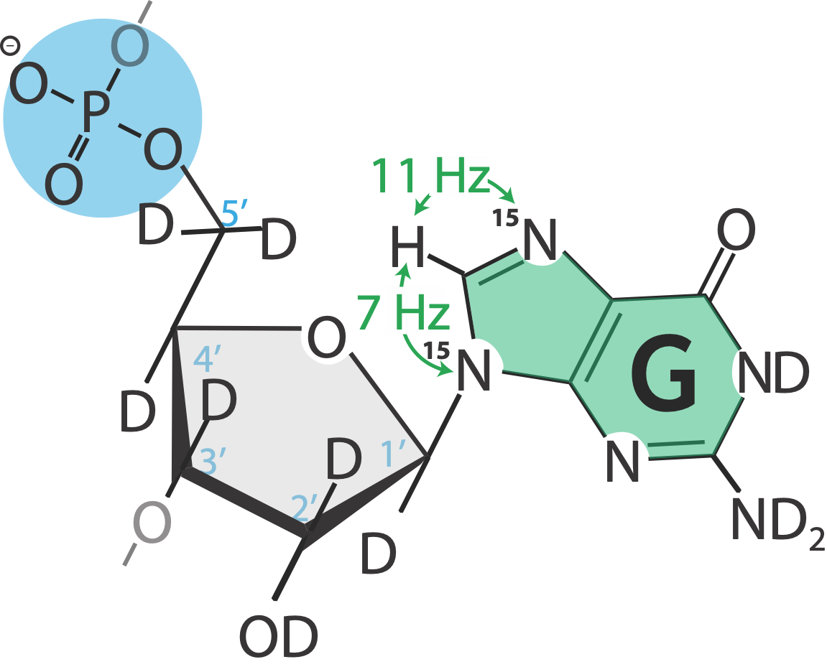
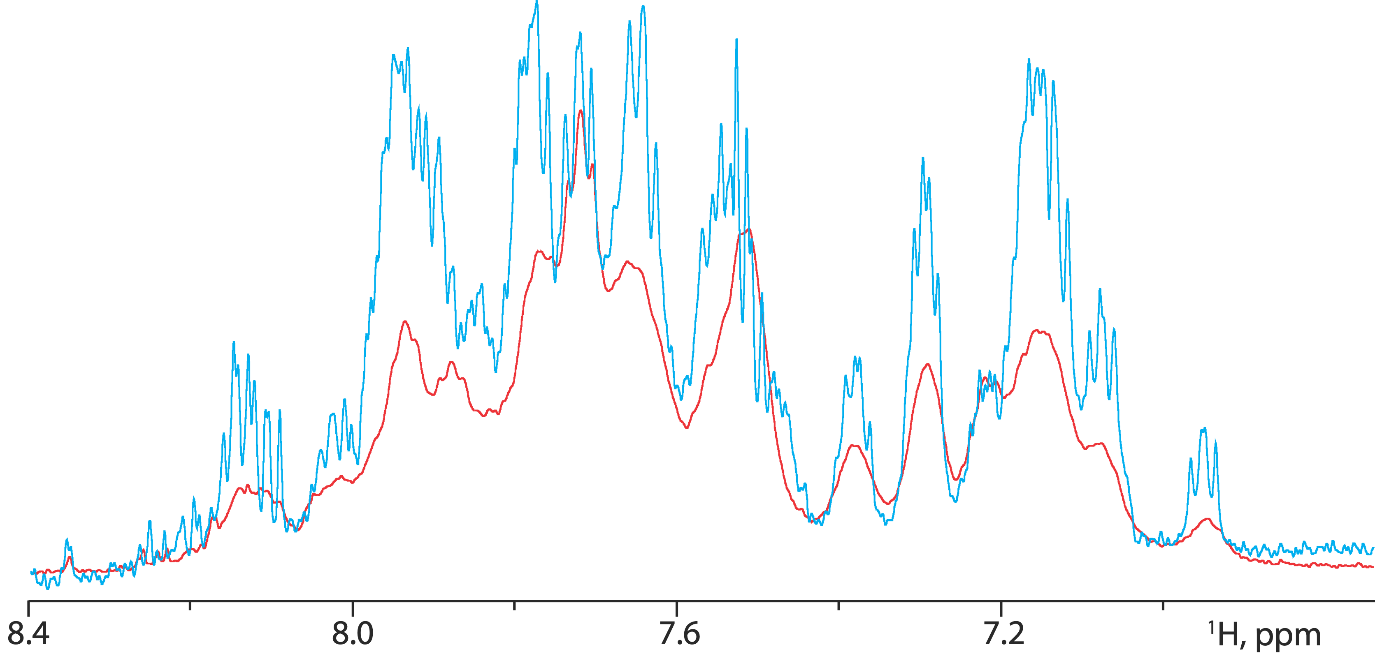
1′,2′,3′,4′,5′,5″-D; U-¹⁵N G, U-²H ACU
U-¹H; U-¹⁵N G, U-²H ACU

Slide 17
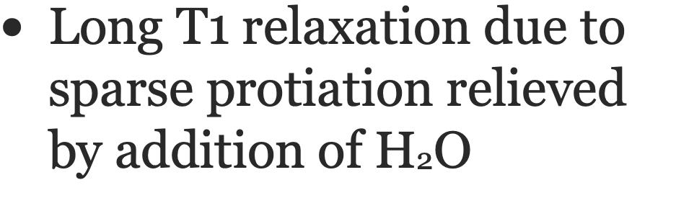
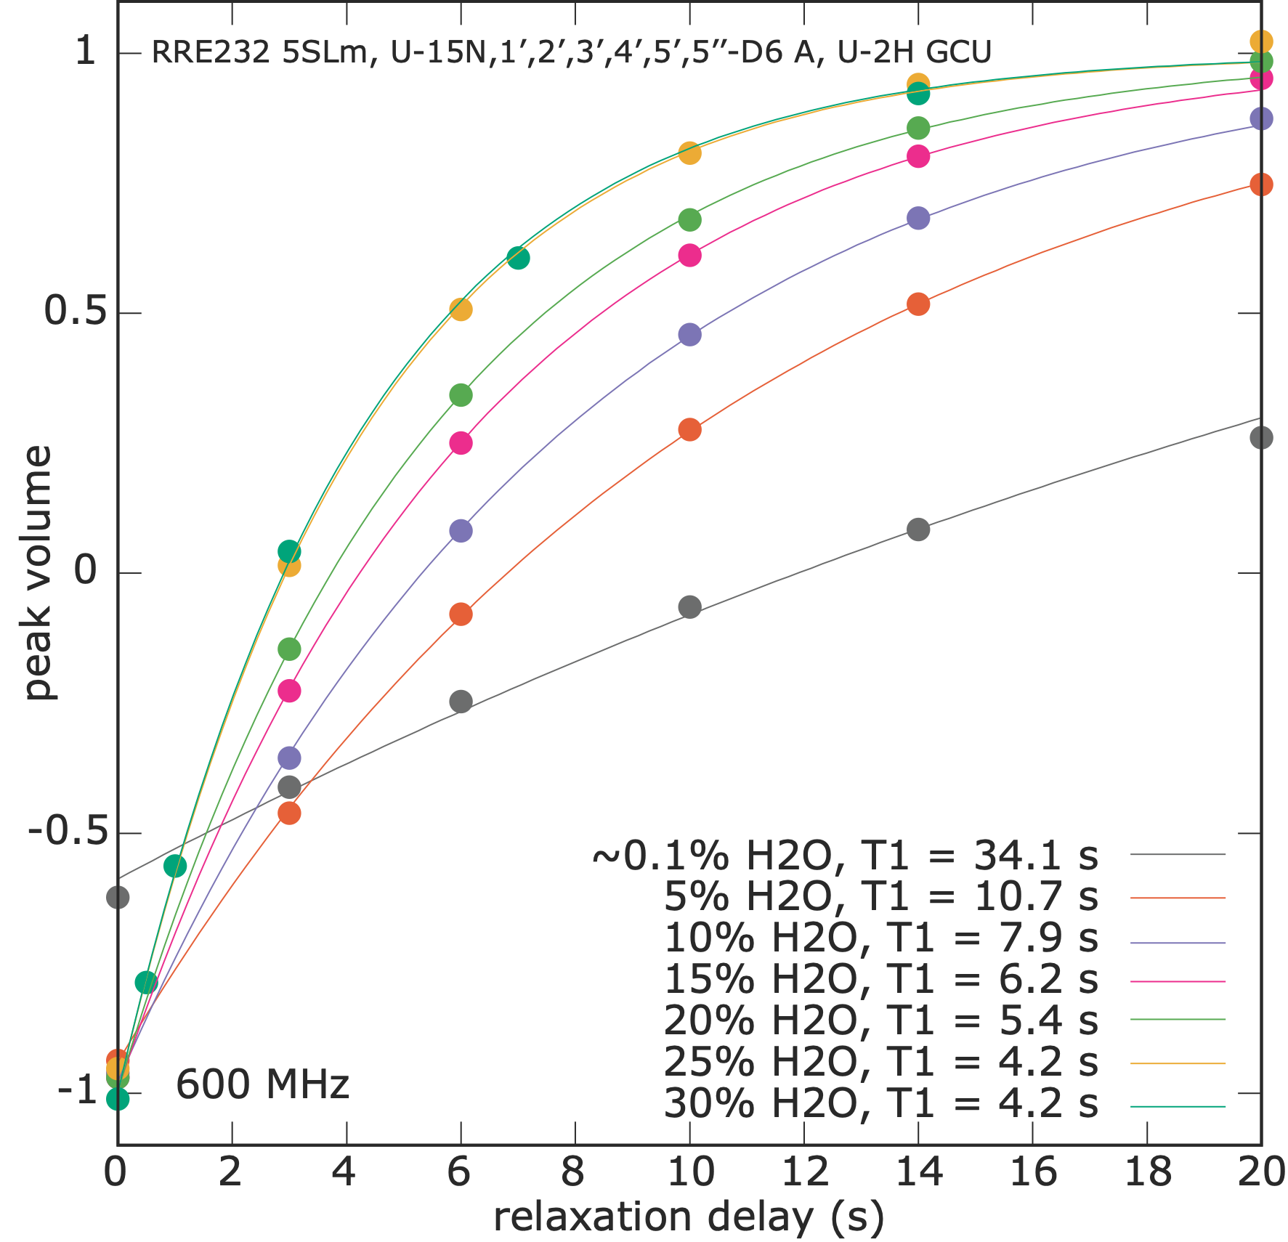
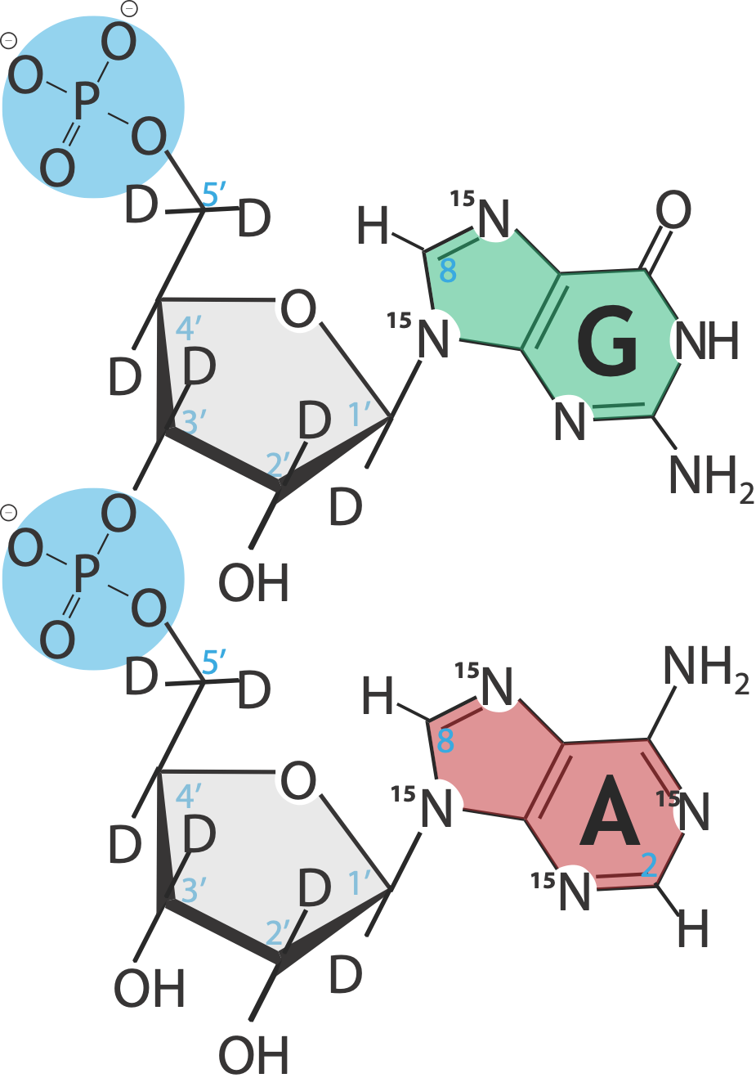

Slide 18
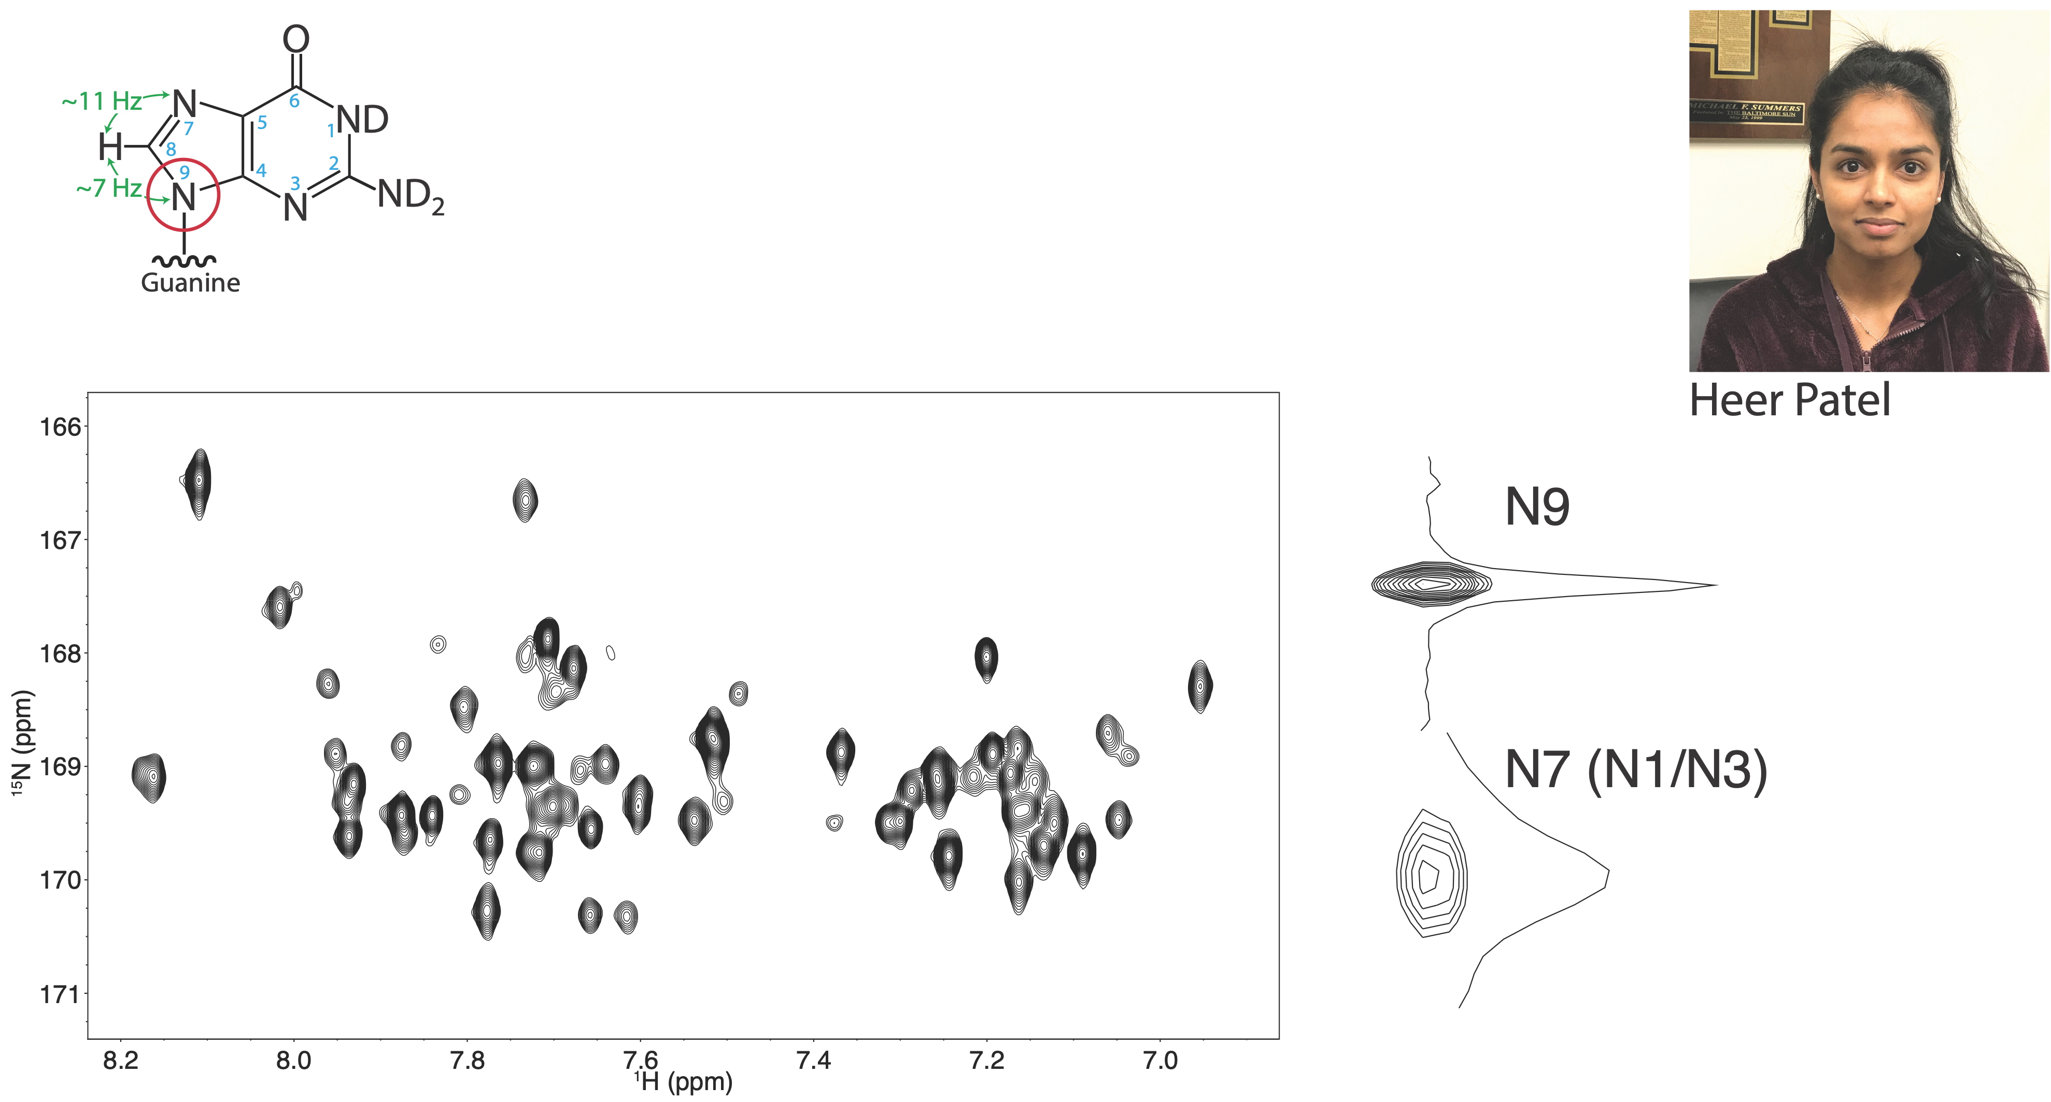
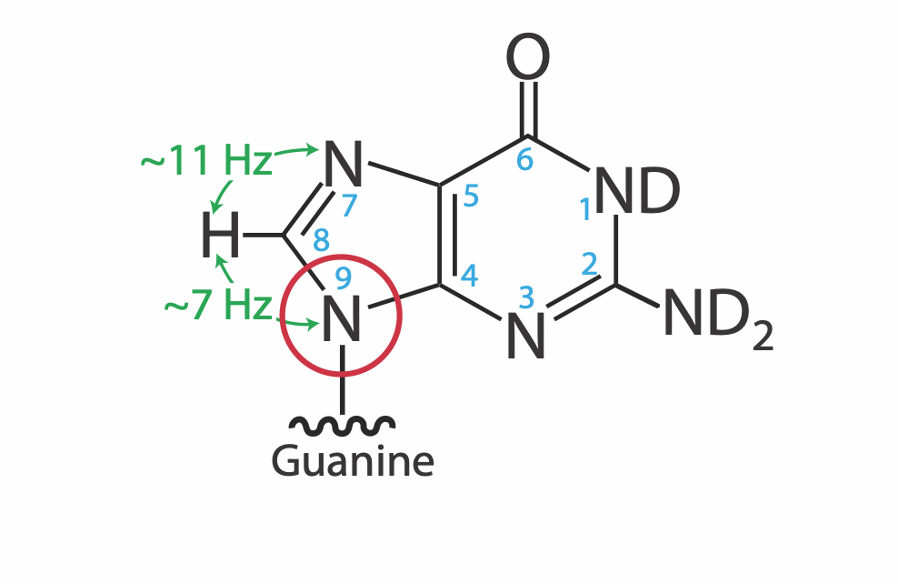

Slide 19
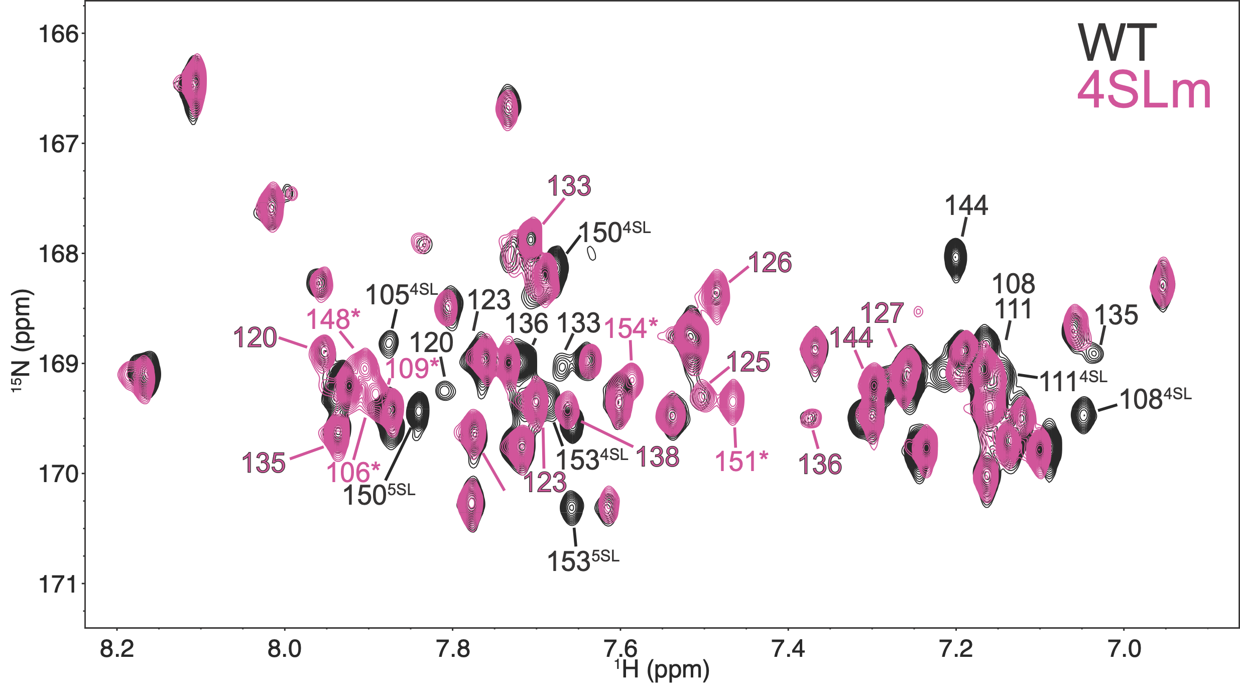
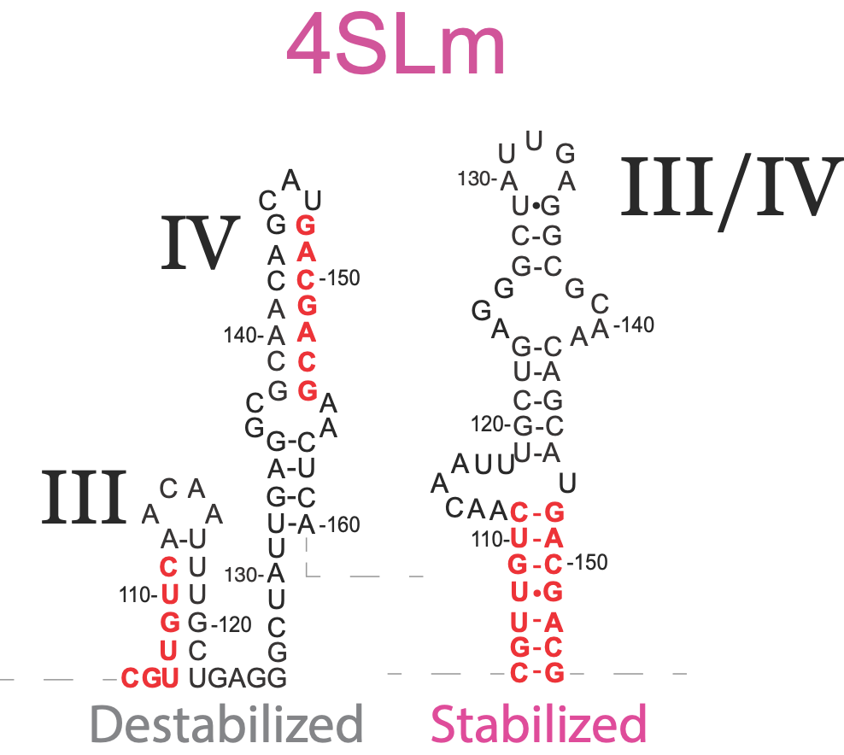

Slide 20
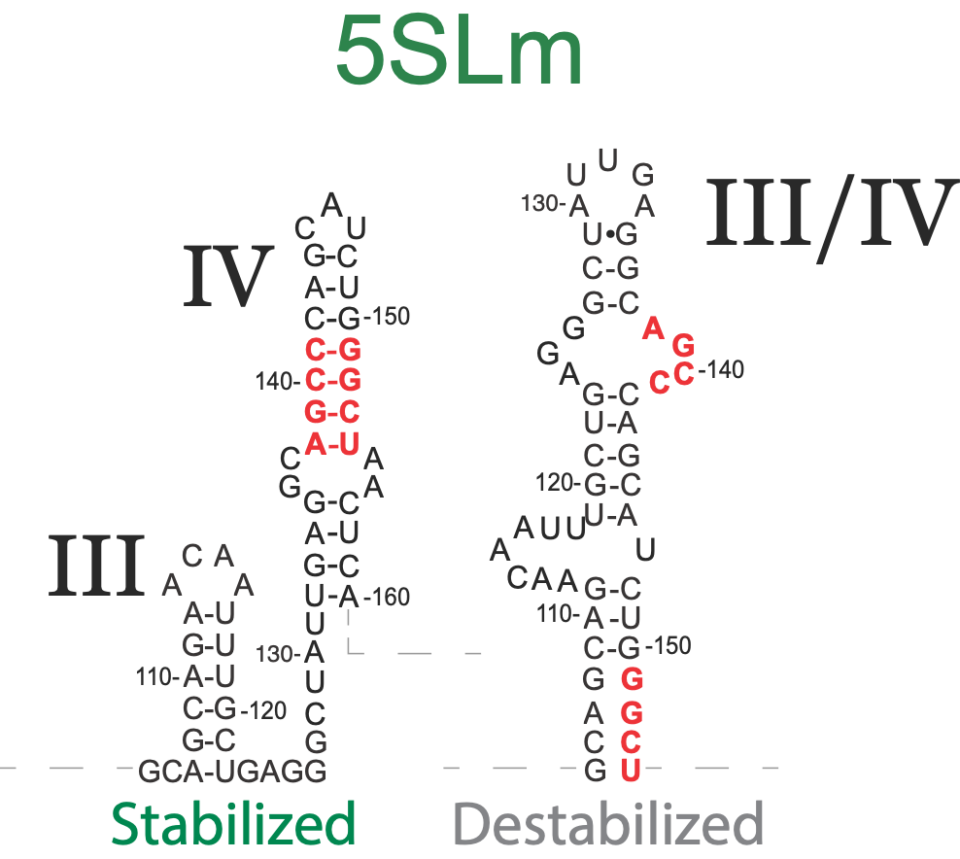
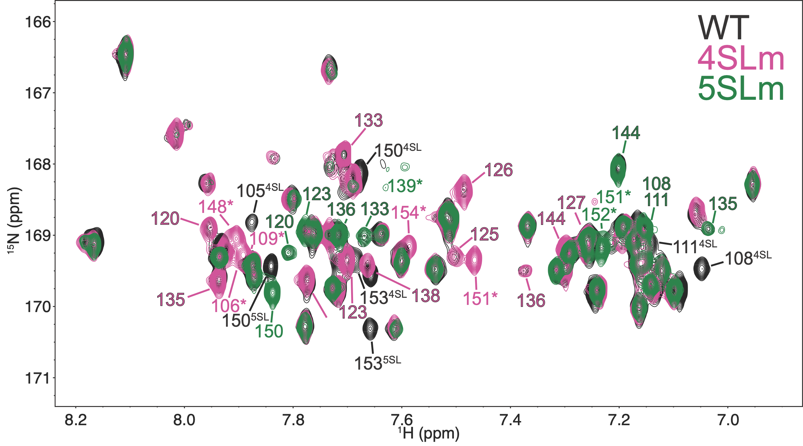

Slide 21
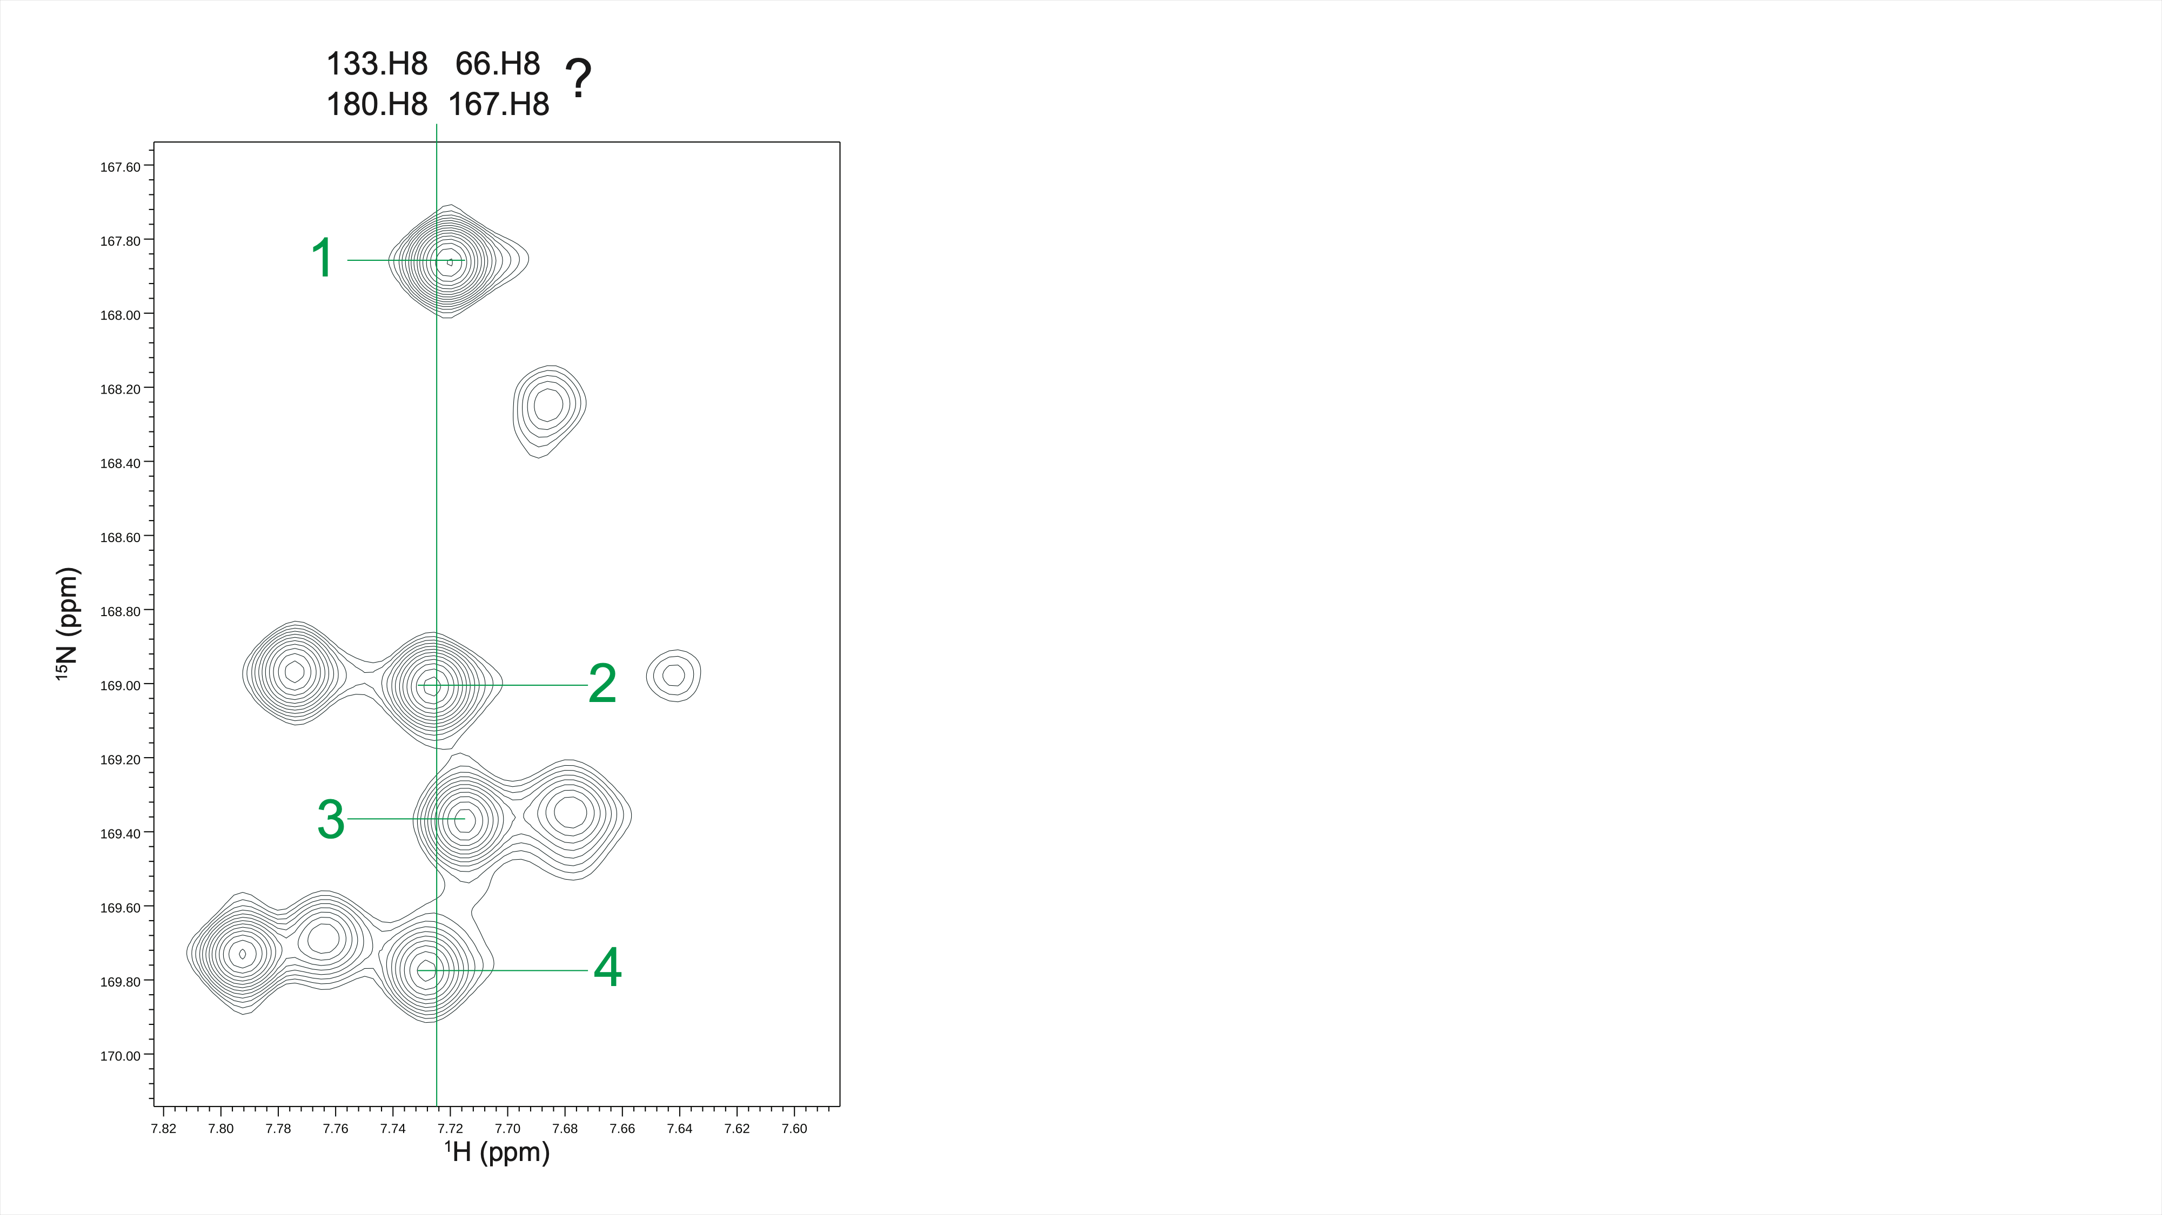

Slide 22
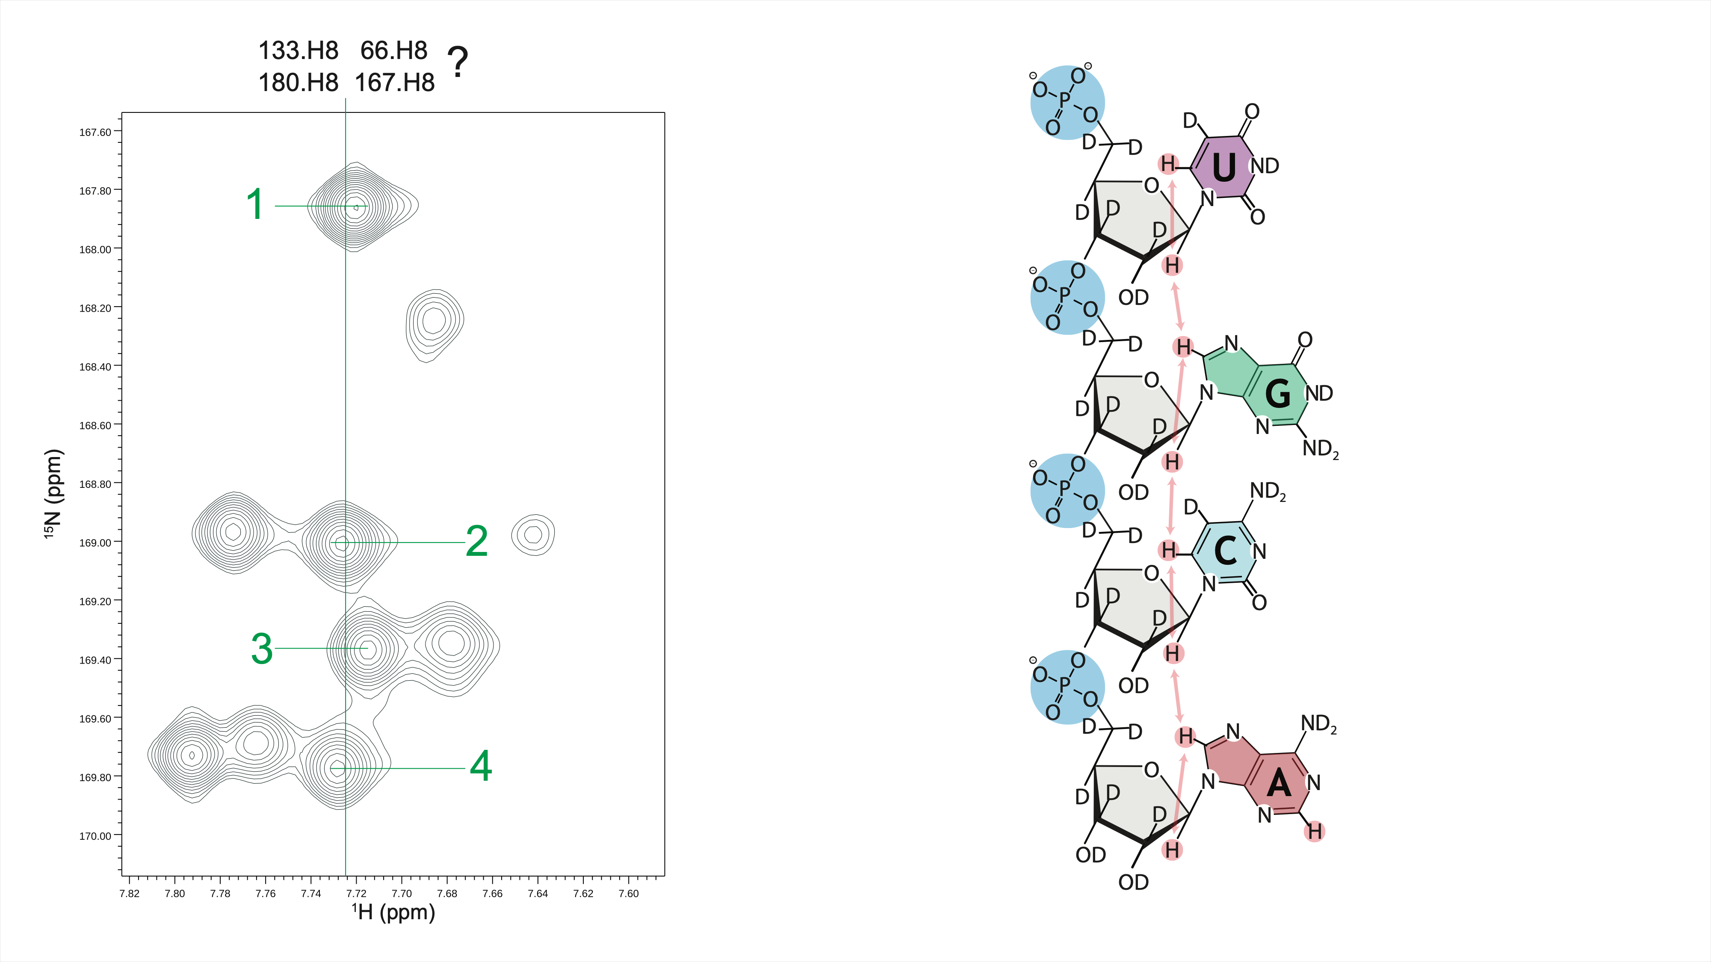

Slide 23
With fully deuterated ribose retain ~ 50%
magnetization after optimal INEPT
With H1′ protiated retain ~ 40%
magnetization after optimal INEPT

Slide 24
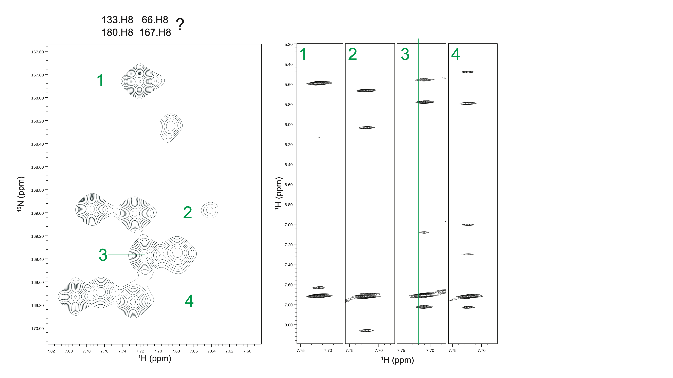

Slide 25
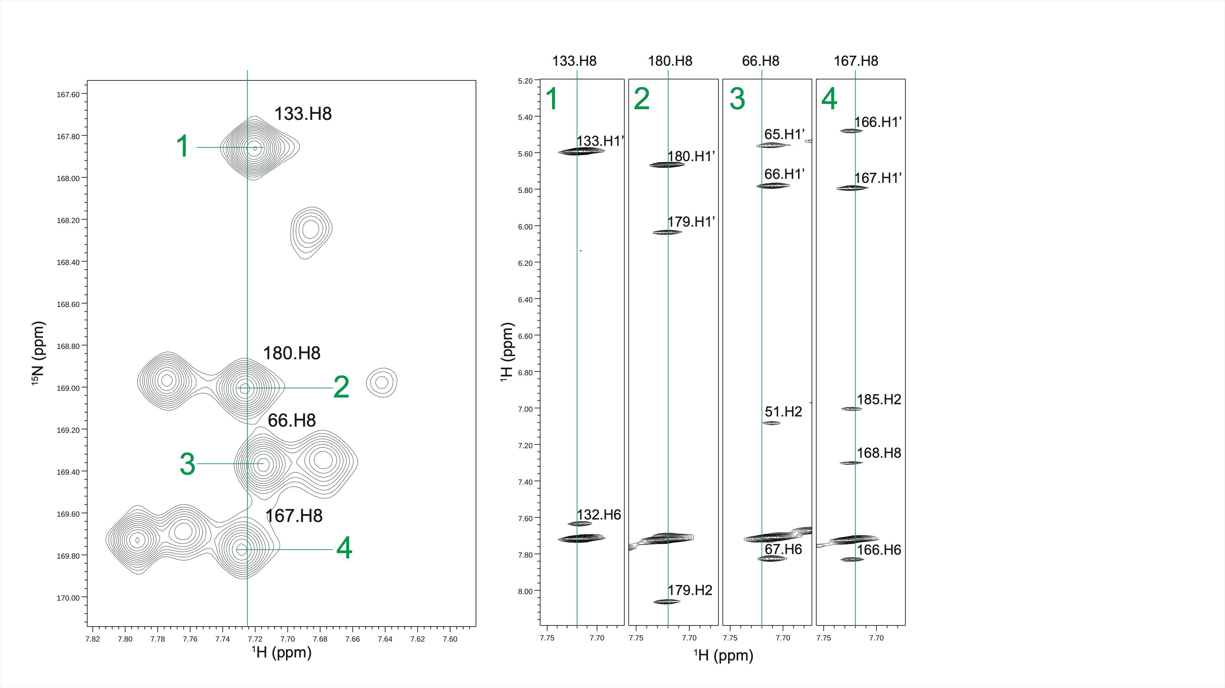

Slide 26
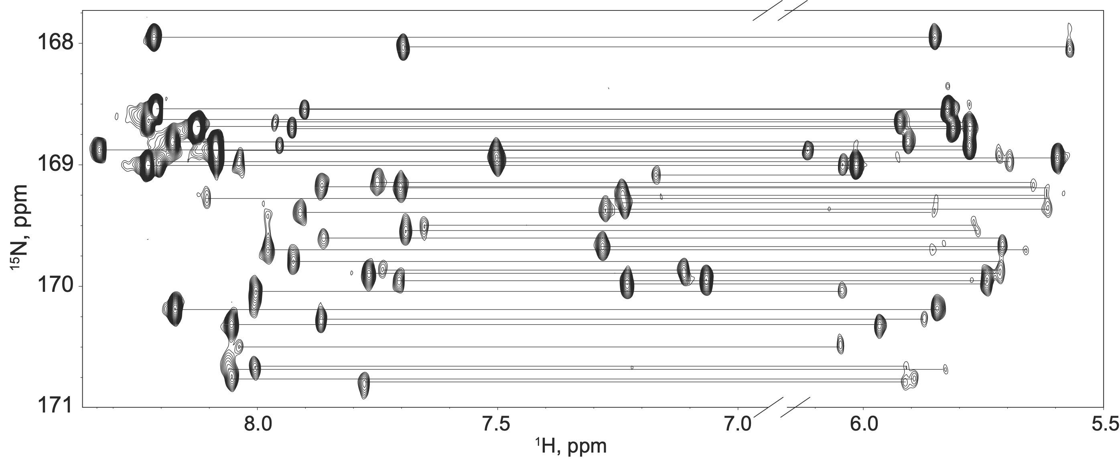

Slide 27


Heer
NIH/NIAID U54 AI540470

